Slide 1

The OHIO STUDY
Interviewer’s Guide
to the Galaxy
P/CG CASI 1490

Slide 2
SA PRACTICE SECTION P/CG CASI 1490
Who is asked this section? The adult resident parent or guardian
Brief outline of topics asked in this section: After getting Parent Consent and Youth Assent, you set the P/CG to self administer the survey.
Anything special about the section? Ask if they want help getting started. If R says yes, then help with three practice questions. Then encourage them to continue by themselves. Otherwise, give the laptop to the youth respondent, and show them to click "SUBMIT" to move forward

Slide 3
SA EMPLOYMENT AND INCOME SECTION
P/CG CASI 1490
Who is asked this section? The adult resident parent or guardian
Brief outline of topics asked in this section: This section inquires about the P/CG paid employment and finances.
Anything special about the section? People talk about sex easier than their own money. Be prepared to reassure P/CG about confidentiality.

Slide 4
SA RELATIONSHIPS SECTION
P/CG CASI 1490
Who is asked this section? The adult resident parent or guardian
Brief outline of topics asked in this section: This section asks the P/CG about their romantic relationship(s).
Anything special about the section? Some of these questions deal with domestic violence. The number to the Netcare Crisis Hotline will be displayed to inform the respondent that there is professional help available regardless of their ability to pay. It’s also a good idea to keep this number written down so if someone asks you can hand it to them. This is the message both parent and child will see after sensitive sections:
Do you have a problem and need help with suicide, abuse, drugs and alcohol or other problems?
Call the Netcare Crisis Hotline at 276-CARE (2273). Services are available to anyone, regardless of the ability to pay.

Slide 5
SA LEGAL SECTION
P/CG CASI 1490
Who is asked this section? The adult resident parent or guardian
Brief outline of topics asked in this section: This section asks questions about anyone in the family or household whomever had frequent trouble with the law, often became involved in fights, had trouble holding a job, or was a frequent discipline problem in school.
Anything special about the section? Have it handy-
Do you have a problem and need help with suicide, abuse, drugs and alcohol or other problems?
Call the Netcare Crisis Hotline at 276-CARE (2273). Services are available to anyone, regardless of the ability to pay.

Slide 6
SA THOUGHTS SECTION
P/CG CASI 1490
Who is asked this section? The adult resident parent or guardian
Brief outline of topics asked in this section: This section asks the P/CG about feelings and thoughts they’ve experienced during the last month.
Anything special about the section? Have it handy-
Do you have a problem and need help with suicide, abuse, drugs and alcohol or other problems?
Call the Netcare Crisis Hotline at 276-CARE (2273). Services are available to anyone, regardless of the ability to pay.

Slide 7
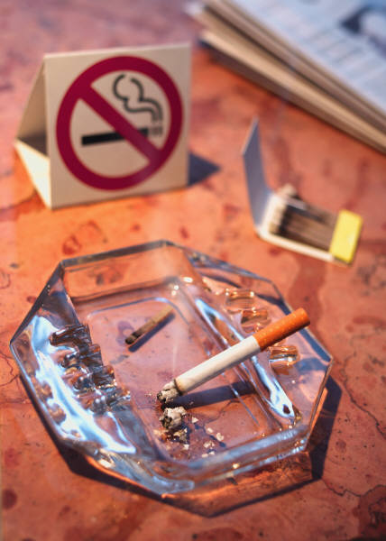
SA TOBACCO AND ALCOHOL SECTION
P/CG CASI 1490
Who is asked this section? The adult resident parent or guardian
Brief outline of topics asked in this section: This section asks the Adult respondent about the Amount/Type of use of tobacco and alcohol
Anything special about the section? Have it handy-
Do you have a problem and need help with suicide, abuse, drugs and alcohol or other problems?
Call the Netcare Crisis Hotline at 276-CARE (2273). Services are available to anyone, regardless of the ability to pay.

Slide 8
SA DRUGS SECTION
P/CG CASI 1490
Who is asked this section? The adult resident parent or guardian
Brief outline of topics asked in this section: The next major section of this questionnaire deals with HH substance abuse.
Anything special about the section? Remind the R about the Federal Certificate of Confidentiality and how it ensures their answers will remain private. Have this handy-
Do you have a problem and need help with suicide, abuse, drugs and alcohol or other problems?
Call the Netcare Crisis Hotline at 276-CARE (2273). Services are available to anyone, regardless of the ability to pay.

Slide 9
SA HEALTH SECTION
P/CG CASI 1490
Who is asked this section? The adult resident parent or guardian
Brief outline of topics asked in this section: This section asks questions about the P/CG typical habits concerning Exercise and Weight.
Anything special about the section? Have it handy-
Do you have a problem and need help with suicide, abuse, drugs and alcohol or other problems?
Call the Netcare Crisis Hotline at 276-CARE (2273). Services are available to anyone, regardless of the ability to pay.

Slide 10

SA RELIGION SECTION
P/CG CASI 1490
Who is asked this section? The adult resident parent or guardian
Brief outline of topics asked in this section: Asks P/CG questions about the type, frequency, and questions concerning the community of their chosen religion.
Anything special about the section? N/A

Slide 11
SA BEHAVIORS SECTION
P/CG CASI 1490
Who is asked this section? The adult resident parent or guardian
Brief outline of topics asked in this section: This section asks the Adult P/CG their typical ways of handling parent/child conflict.
Anything special about the section? Have it handy-
Do you have a problem and need help with suicide, abuse, drugs and alcohol or other problems?
Call the Netcare Crisis Hotline at 276-CARE (2273). Services are available to anyone, regardless of the ability to pay.

Slide 12
SA BIO PARENTS SECTION
P/CG CASI 1490
Who is asked this section? The adult resident parent or guardian
Brief outline of topics asked in this section: This section asks questions about the Adult Respondents current relationship status with other biological parent
Anything special about the section? N/A

Slide 13
SA CHILDHOOD SECTION
P/CG CASI 1490
Who is asked this section? The adult resident parent or guardian
Brief outline of topics asked in this section: This section inquires about the youth respondents early childhood.
Anything special about the section? N/A

Slide 14
SA CH HEALTH SECTION
P/CG CASI 1490
Who is asked this section? The adult resident parent or guardian
Brief outline of topics asked in this section: This section asks about Child height, weight, health conditions, and prescriptions.
Anything special about the section? Very important that we know if a youth is taking any corticosteroid medications as these will skew the bio-marker results.

Slide 15

SA CH SCHOOL SECTION
P/CG CASI 1490
Who is asked this section? The adult resident parent or guardian
Brief outline of topics asked in this section: This section asks about Parental involvement at child’s school
Anything special about the section? N/A

Slide 16
SA FAMILIES SECTION
P/CG CASI 1490
Who is asked this section? The adult resident parent or guardian
Brief outline of topics asked in this section: This section asks True/False statements concerning family.
Anything special about the section? N/A

Slide 17
SA TECHNOLOGY SECTION
P/CG CASI 1490
Who is asked this section? The adult resident parent or guardian
Brief outline of topics asked in this section: This section asks about Youth’s typical cell phone use.
Anything special about the section? N/A

Slide 18
SA THANK YOU
P/CG CASI 1490
Who is asked this section? The adult resident parent or guardian
Brief outline of topics asked in this section: This section asks for last 4 digits of SS, or permission to try to link to admin data without this. End of Visit 1 Survey at ADMIN_THANKS
Anything special about the section? THIS IS THE LAST SECTION OF VISIT 1!!!!

Slide 19
NEIGHBORHOOD SECTION
P/CG CASI 1490
FIRST ACTIVITY ON VISIT 2!
Who is asked this section? The adult resident parent or guardian
Brief outline of topics asked in this section: This section covers characteristics of the HH’s self-defined neighborhood.
Anything special about the section? Begin during VISIT 2!!!

